Slide 1
Adjective Clauses & Reductions
Grammar Lesson 4
By Tabby Self
October 21, 2022

Slide 2
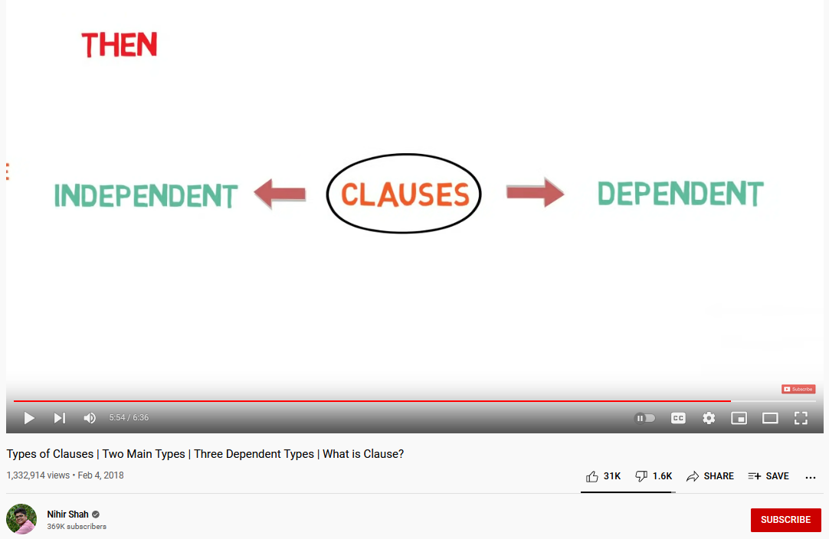

Let’s
Watch
a Video.
https://www.youtube.com/watch?v=8dT_MlElHo8

Slide 3
DEFINITIONS
ADJECTIVE
A word that describes a noun
The talented student wrote a beautiful poem.
CLAUSE
A group of words with a subject and verb
INDEPENDENT: The student wrote a poem.
DEPENDENT: who is talented
ADJECTIVE CLAUSE
A dependent group of words with a subject and verb that begins with a relative pronoun and describes a noun
The student who is talented wrote a poem.
S
V
O
student
wrote
poem
Not a complete thought Cannot stand alone
relative pronoun

Slide 4
COMPLETE MEANING
CLAUSE
TYPES
Noun Clause
Adjective Clause (relative clause)
Adverb Clause
Main Clause
complete thought
INDEPENDENT
DEPENDENT
can stand alone
can’t stand alone

Slide 5
RELATIVE PRONOUNS
who
whom
whose
that
which
where
when
What is a pronoun?
time
people
RELATIVE PRONOUNS
A word that replaces a noun
place
things

Slide 6
STRUCTURE
EXAMPLE
SYNTAX
2 NOUNS
The student who is talented wrote a poem.
The student wrote a poem that was beautiful.

Slide 7
STRUCTURE
EXAMPLE
SYNTAX
Main Clause
The student who is talented wrote a poem.
The student wrote a poem that was beautiful.
S
V
O

Slide 8
STRUCTURE
EXAMPLE
SYNTAX
Adjective Clause
The student who is talented wrote a poem.
The student wrote a poem that was beautiful.
S
V
relative pronoun

Slide 9
STRUCTURE
EXAMPLE
SYNTAX
The student who is talented wrote a poem.
The student wrote a poem that was beautiful.
S
V
O
Main Clause

Slide 10
STRUCTURE
EXAMPLE
SYNTAX
The student who is talented wrote a poem.
The student wrote a poem that was beautiful.
relative pronoun
S
V
Adjective Clause

Slide 11
STRUCTURE
RELATIVE PRONOUN
What is the purpose of who and that?
FUNCTION
The student who is talented wrote a poem.
The student wrote a poem that was beautiful.
relative pronoun
relative pronoun

Slide 12
STRUCTURE
RELATIVE PRONOUN
SUBJECT
FUNCTION
The student who is talented wrote a poem.
The student wrote a poem that was beautiful.
S
V
relative pronoun
relative pronoun
S
V

Slide 13
RELATIVE PRONOUNS
who
whom
whose
that
which
where
when
Which act as subjects?
RELATIVE PRONOUNS

Slide 14
STRUCTURE
LOCATION
SYNTAX
Where are adjectives normally found?
Before the noun
The talented student wrote a beautiful poem.
The student who is talented wrote a poem that was beautiful.

Slide 15
STRUCTURE
LOCATION
SYNTAX
Where are adjective clauses found?
The talented student wrote a beautiful poem.
The student who is talented wrote a poem that was beautiful.
After the noun

Slide 16

REDUCTIONS
OMIT
Prepositional Phrase
The student who is in the class wrote a poem.
The student in the class wrote the poem.
Present Participle
The student that is leaving wrote a poem.
The student leaving wrote a poem.
Past Participle
The student wrote a poem which had been chosen for the award.
The student wrote a poem chosen for the award.
subject
+
to be
3 SCENARIOS
ACTIVE

Slide 17
REDUCTIONS
REDUCE
subject
+
verb
The student who writes the most will win the prize that awards the most money.
The student writing the most will win the prize awarding the most money.
1 SCENARIO
ACTIVE

Slide 18

ACTIVITY
Hidden Miracles of the Natural World
“We’re giants, and we’re unaware of the things that are too small for us to see. The electron microscope fires electrons which creates images which can magnify things by as much as a million times. This is the egg of a butterfly. And there are unseen creatures living all over your body, including mites that spend their entire lives dwelling on your eyelashes, crawling over your skin at night.”
--Louie Schwartzberg
Find the 8 adjective clauses.

Slide 19
ACTIVITY
Hidden Miracles of the Natural World
“This is the egg of a butterfly. And there are unseen creatures that live all over your body and which include mites that spend their entire lives and which dwell on your eyelashes and which crawl over your skin at night.”
Notice the 4 reductions.

Slide 20

REFERENCES
ASSIGNMENTS
ARP: Conclusion: due 10/23/2022
Vocabulary e-Journals: due 11/9/2022
Blass, L., Vargo, M., & Wisniewska, I. (2016). 21st century reading: Creative thinking and reading with TEDTALKS 3, National Geographic/Cengage Learning.
Elbaum, S. N. (2016). Grammar in context 2 (6th ed.). Cengage Learning, Inc.
Folse, K. (2016). Keys to Teaching Grammar to English language learners: A practical handbook (2nd ed.). University of Michigan Press.
Merriam-Webster. (n.d.). Adjective. In Merriam-Webster.com dictionary. Retrieved November 12, 2021, from https://www.merriam-webster.com/dictionary/adjective
Merriam-Webster. (n.d.). Clause. In Merriam-Webster.com dictionary. Retrieved November 12, 2021, from https://www.merriam-webster.com/dictionary/clause
Merriam-Webster. (n.d.). Pronoun. In Merriam-Webster.com dictionary. Retrieved November 12, 2021, from https://www.merriam-webster.com/dictionary/pronoun
Shah, N. (2018, February 4). Types of clauses | two main types | three dependent types | what is clause? [Video]. YouTube. https://www.youtube.com/watch?v=8dT_MlElHo8

